Slide 1
Comprehensive HIV response under the Sustainable Development Era WHO European Region’s perspective
22nd International AIDS Conference
Amsterdam, 24 July 2018
Dr Zsuzsanna Jakab
WHO Regional Director for Europe

Slide 2
Estimated new HIV infections, 2000-2017 and 2020 target Eastern Europe and Central Asia (EECA) and Western and Central Europe (WCE)
Source: UNAIDS 2018 estimates

Slide 3
1in 8
New TB patients notified in the Region in 2016 was HIV positive

Slide 4
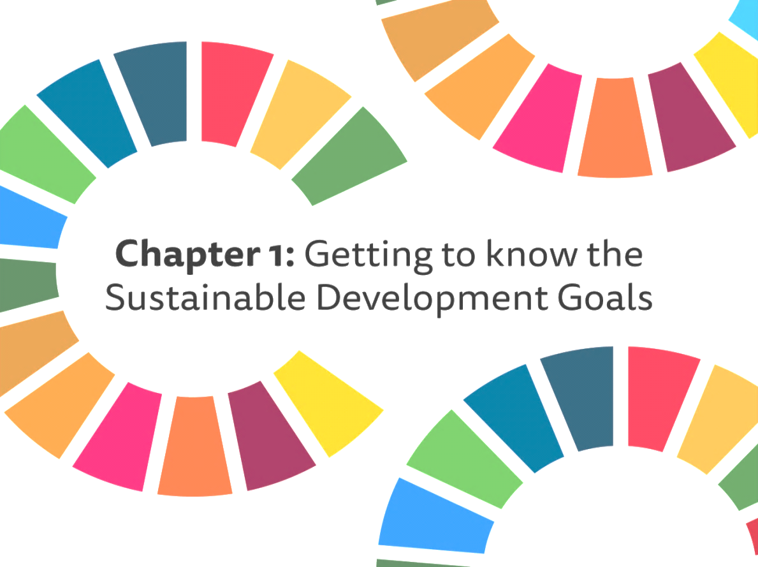
WHO PRIORITIES IN THE 2030 Agenda
Intersectoral action by multiple stakeholders
Health systems strengthening for Universal Health Coverage (UHC)
Respect of equity and human rights
Sustainable financing
Scientific research and innovation
Monitoring and evaluation

Slide 5
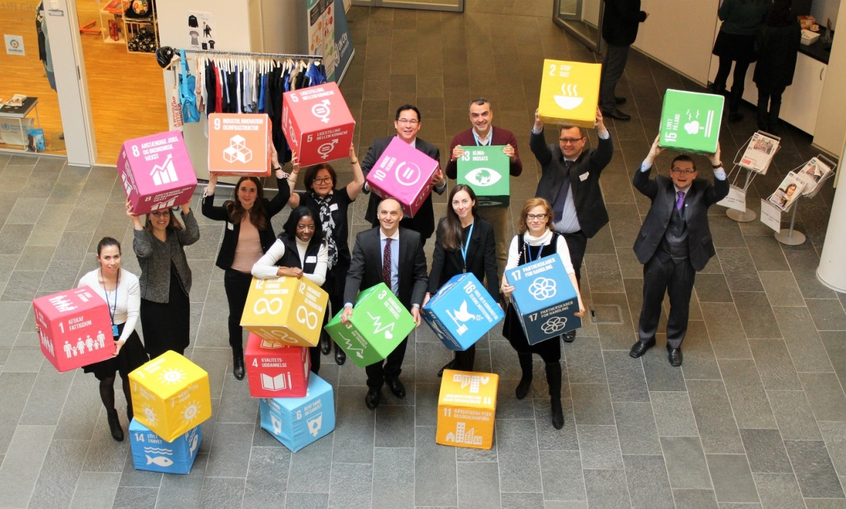
The Regional Issue-based Coalition on health and well-being
Common Position Paper on intersectoral collaboration to end TB, HIV and Viral Hepatitis
To adopt an intersectoral approach to address inequities by tackling Social, Environmental and Economic Determinants of health
Developed by WHO and 14 UN sister agencies
WHO and UNAIDS, UNDP, UNFPA, UNICEF, UNHCR, UNOPS, UNODC, IOM, FAO, UNWOMEN, UNHABITAT, ILO , OHCHR, Stop TB Partnership

Slide 6
Action plan for the health sector response to HIV
Strategic Direction 1
Information for focused action
Strategic Direction 2
Interventions for impact
Strategic Direction 5
Innovation for acceleration
Strategic Direction 4
Financing for sustainability
Strategic Direction 3
Delivering for equity
The three dimensions of UHC
Frameworks for action: Universal health coverage, the continuum of services, a public health approach
Frameworks for action: universal health coverage, the continuum of services, a public health approach

Slide 7
Strategic Direction 4: Financing for sustainability
Fast-track actions:
Finance a sustainable HIV response to achieve the 90-90-90 targets
Strengthen procurement and supply management
Remove health-related financial risk for PLHIV
Expand innovative financing models and build strategic partnerships

Slide 8
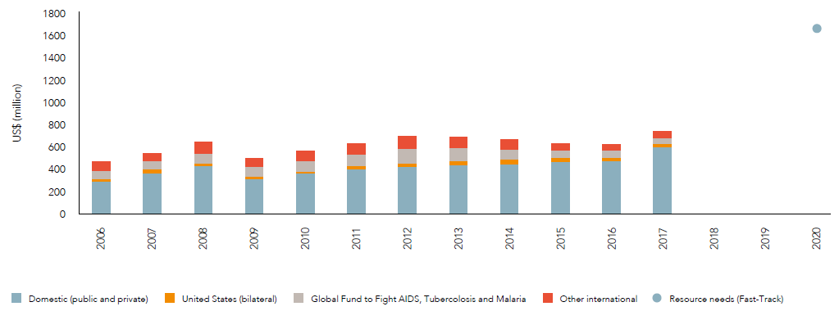
HIV resource availability 2006-2017 and projected resource needs by 2020, eastern Europe and Central Asia
Source: UNAIDS. Global AIDS Update 2018.
Estimates for low- and middle income countries per 2015 World Bank income level classification.

Slide 9
Efficiency gains interventions
Adopting WHO recommended treatment regimens
Efficient procurement and supply
Use of strategic information for focused planning and high impact interventions
Full engagement of community-based service provision
Reforming health financing and service delivery
Re-distribution of roles of health workforce for differentiated care

Slide 10
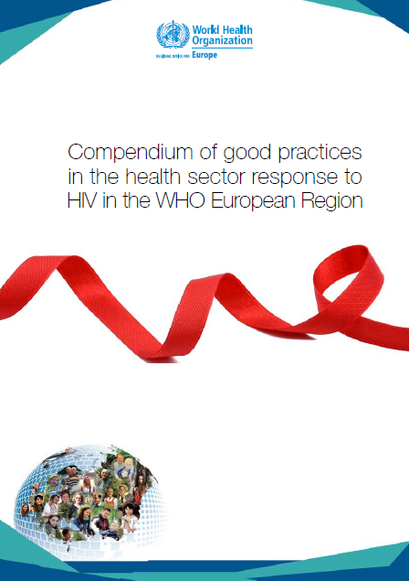
Call for action
Jointly review lessons learned in domestic financing for a fully funded HIV response
Mobilize innovative financing mechanisms and strategic partnerships
Sustained efforts to ensure affordability of antiretroviral medicines
UHC for integrated, people-centered care, including community based services
Exchange good practices and innovative approaches

Slide 11
Thank you very much for your attention
Contact:
eurohiv@who.int www.euro.who.int/aids

